Slide 1

ACCESSIBILITY AND INCLUSION
BY
DIGITAL INCLUSION & SKILLS DEVELOPMENT AND
INCUSION OF PWD’S AND UNDERSERVED COMMUNITIES
Presented by
Afọlábí Tolulope Irapada

Slide 2
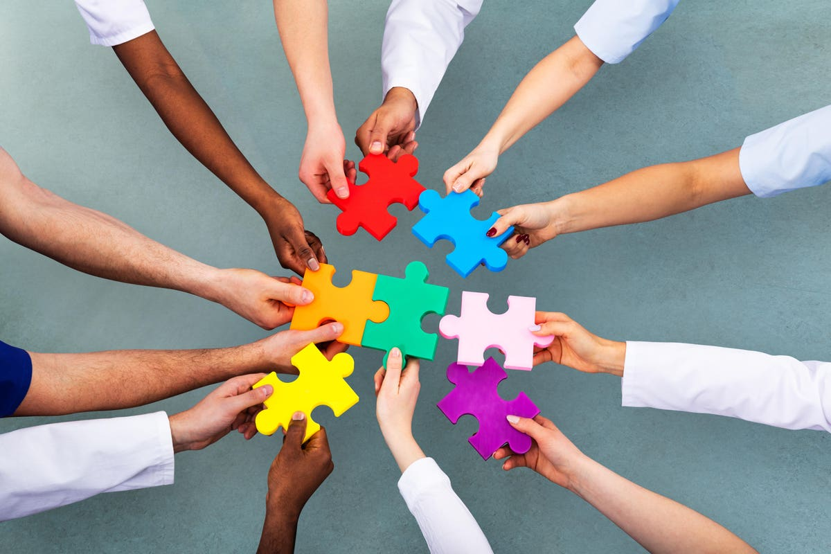
INTRODUCTION
Undeserved communities consist of people that are denied their abilities through unavailability of information, they are like people with super powers but are not aware of it. Likewise people with disabilities, their greatest form of disability is non-inclusion, denying them from growth and skills that will serve as form of livelihood thereby fostering their quotas in society.

Slide 3

What is accessibility and inclusion?
Accessibility means the possibility of an individual, with or without problems of mobility or sensory perception, to understand a space, integrate into it, or interact with its content. Inclusion, according to Ban Ki-moon, 8th Secretary-General of the United Nations (2015), is “Building a sustainable, inclusive world for all requires the full engagement of people of all abilities,”

Slide 4
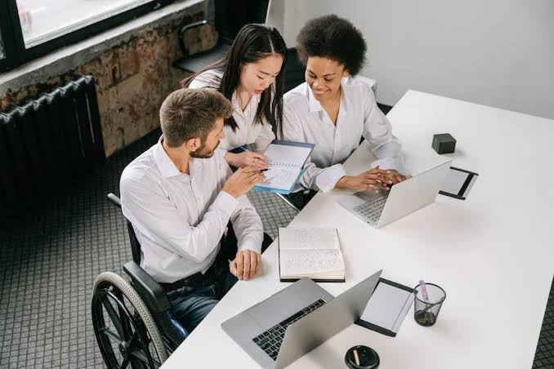
What is accessibility and inclusion?
This involves removing access barriers affecting those who want to interact with digital content. These barriers might include inaccessible systems, a lack of skills or understanding by the user, or the lack of devices or connectivity to digital content. Digitalization of learning, working, and skill development, has experienced another leap since the pandemic, COVID-19, and this has led to a digital divide that reinforces social and economic disparities.

Slide 5
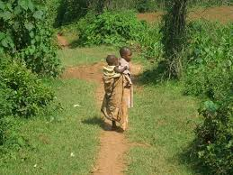
People with disabilities and underserved areas
According to Adam and Kreps 2009, people with disabilities are known as individuals with deficit abilities in which social inclusion is a pursuit rather than a secured state. It was reported by WHO in 2011 that they arguably live in a society designed for the numerically disability-free majority and face an increased risk of social exclusion, as they ‘do not have equal access to health care, education, and employment opportunities, do not receive the disability-related services that they require, and experience exclusion from everyday life activities’.

Slide 6
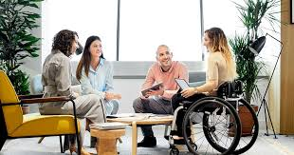
People with disabilities and underserved areas
Also, they often live in low-income households and the mobility and accessibility issues they often encounter decrease their participation in civic activities (Gov.UK 2014; papworthtrust.org.uk 2013; Sourbati 2012) The term ‘disabled people’ is often used in both scholarly and non-scholarly discussions. While scholars such as Dan Goodley make use of the term ‘disabled people’, the term PwD is often used by the advocacy movement that aims to put the person before the disability. In this paper, the preference is for PwD, as this term approaches a certain aspect of those people’s bio-medical status, without characterising them as ‘disabled’ and thus without defining their identity by their disability.

Slide 7
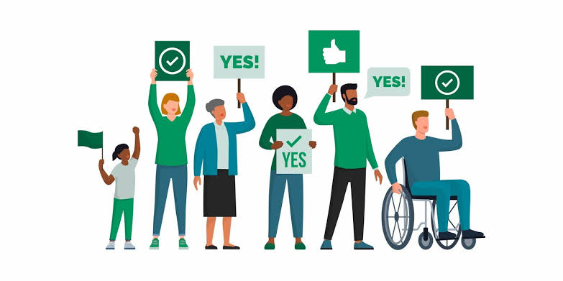
Digital inclusion and accessibility
To seize opportunities presented by digitalization and to keep up with new jobs requirements, equipping oneself with digital skills has become essential. Research carried out by the World Economic Forum predicts that 54 percent of the population will need strong reskilling by 2022 – and this need is even more pressing for developing countries. Digital skills are not mere a necessity for decent employment for individuals, but also a driver of social inclusion. Some initiatives and businesses are working to empower communities with necessary digital skills and assist them to be employed and included, regardless of their genders, background, and physical conditions.

Slide 8
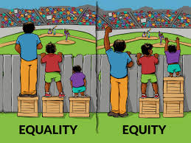
Probable Solutions For inclusion & Accessibility for pwd’S & underserved communities
1. Accessible Infrastructure
- Ensure public spaces, transportation, and buildings are designed with accessibility features like ramps, elevators, and tactile paths.
2. Inclusive Policies
- Implement and enforce policies that promote equal opportunities, including anti-discrimination measures and accommodations for PWDs.
3. Education and Awareness
- Conduct awareness campaigns to educate communities about the needs and abilities of PWDs, fostering understanding and reducing stigma.

Slide 9
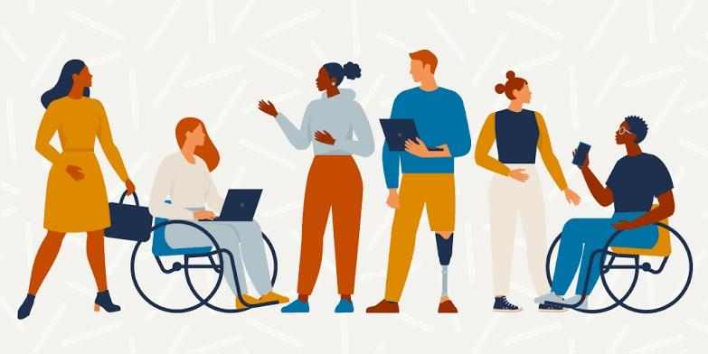
Probable Solutions For inclusion & Accessibility for pwd’S & underserved communities
4. Employment Opportunities
- Encourage businesses to create inclusive workplaces by providing reasonable accommodations, flexible work arrangements, and equal opportunities for hiring and career advancement.
5. Technology for Inclusion
- Leverage technology to enhance accessibility, such as screen readers, voice recognition software, and adaptive devices.
6. Community development
Involve PWDs and underserved communities in decision-making processes to ensure their voices are heard and their specific needs are considered.

Slide 10
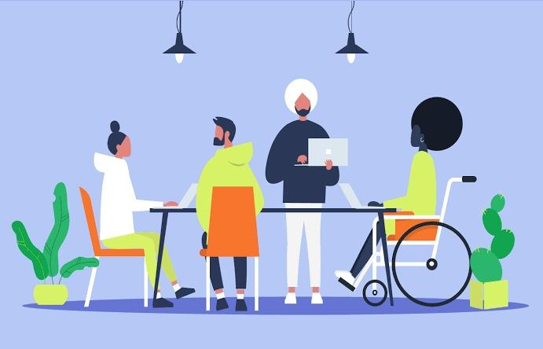
Probable Solutions For inclusion & Accessibility for pwd’S & underserved communities
7. Collaboration with NGOs - Partner with non-governmental organizations (NGOs) and community groups working on inclusion to leverage their expertise and resources.
8. Training Programs - Develop training programs for educators, employers, and service providers to enhance their understanding of inclusivity and equip them with the skills to implement it effectively. Involving various stakeholders is essential for successful implementation.

Slide 11

Thank You

